Slide 1

Efficient Processing of Deep Neural Networks
2022.05.24
발표자 : 권준범

Slide 2
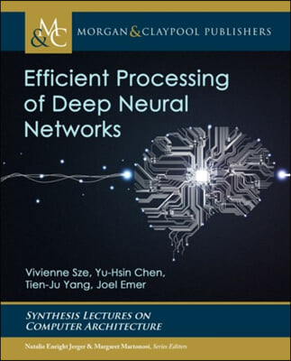
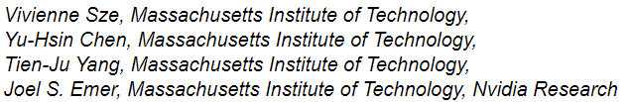
저자 및 논문
Eyeriss: An Energy-Efficient Reconfigurable Accelerator for Deep Convolutional Neural Networks
Tutorials by Vivienne Sze:
https://slideslive.com/38922815/efficient-processing-of-deep-neural-network-from-algorithms-to-hardware-architectures

Slide 3
목차
1. Why NPU(Neural Processing Unit)?
2. Key Metrics and Design Objectives
3. GPU & GPU Platforms
4. Specialized / Domain-Specific Hardware

Slide 4
Why NPU(Neural Processing Unit)?

Slide 5

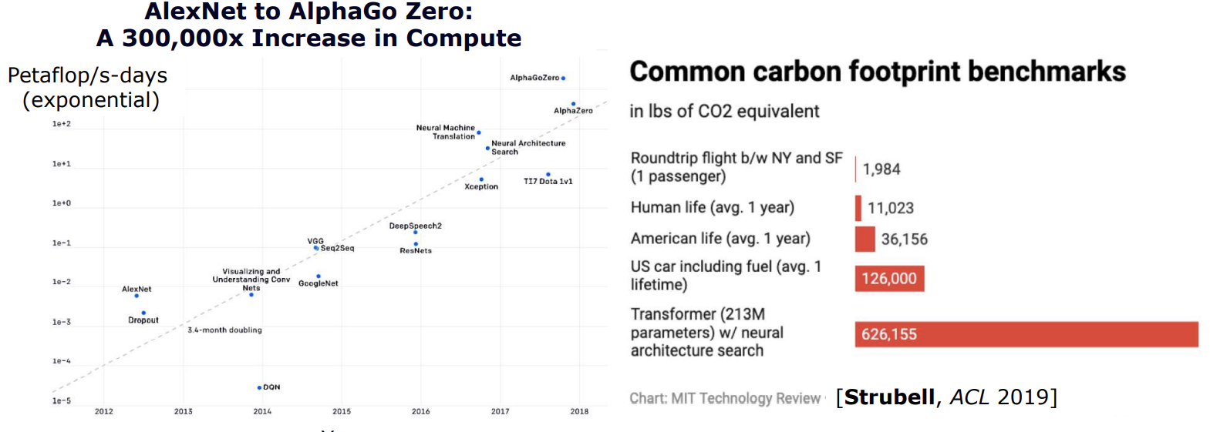

Slide 6

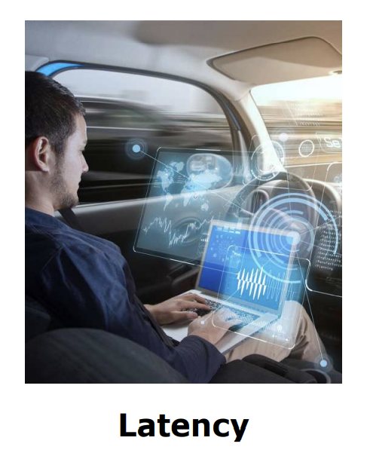
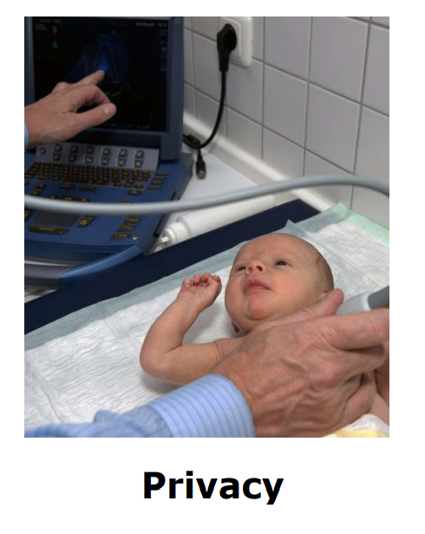

Slide 7

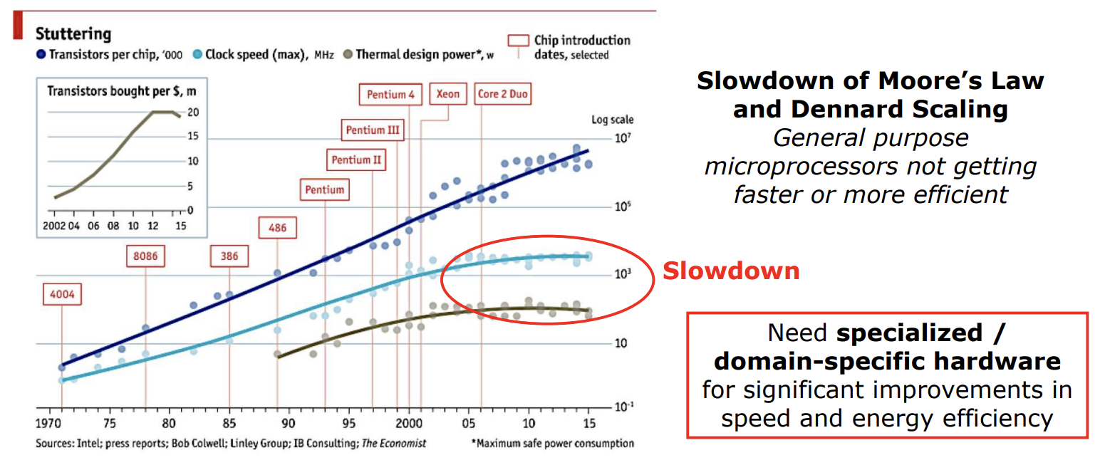

Slide 8

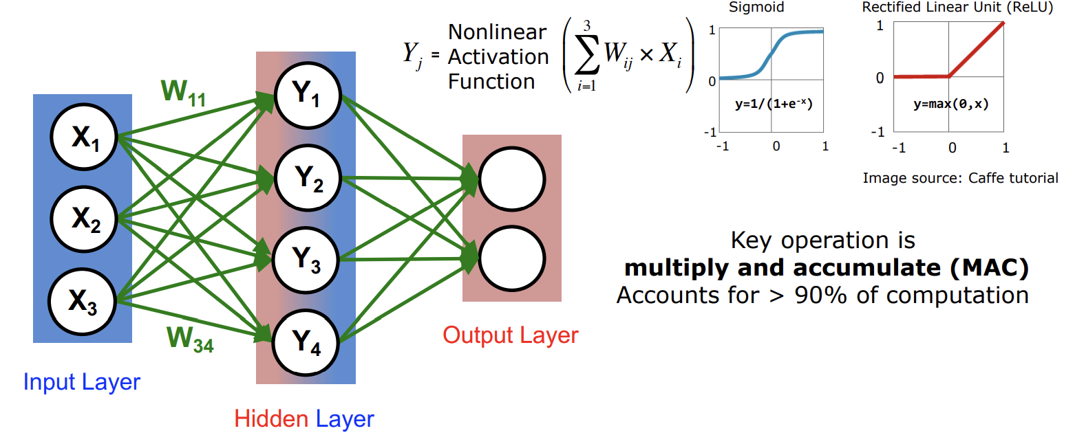

Slide 9

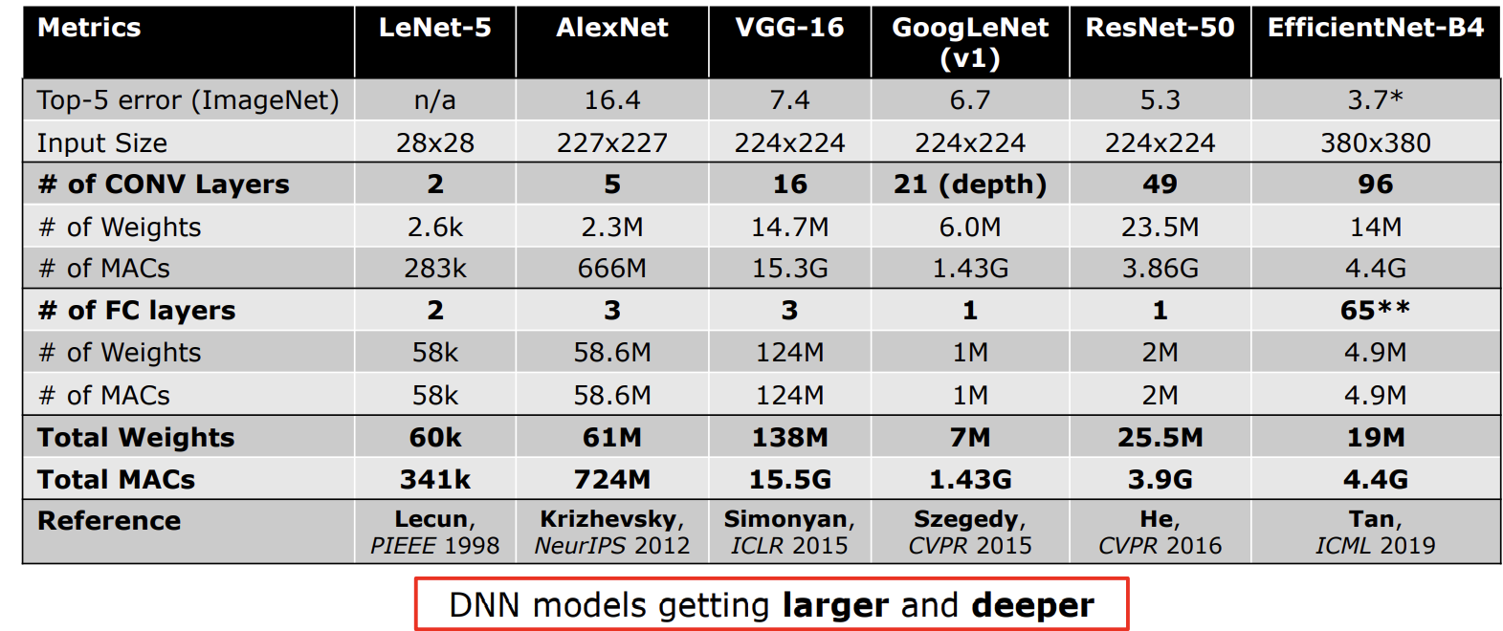

Slide 10
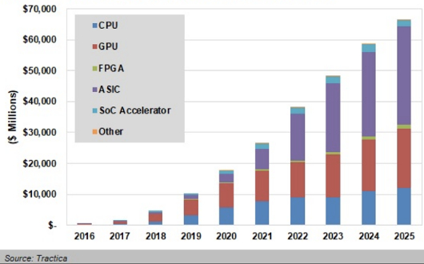
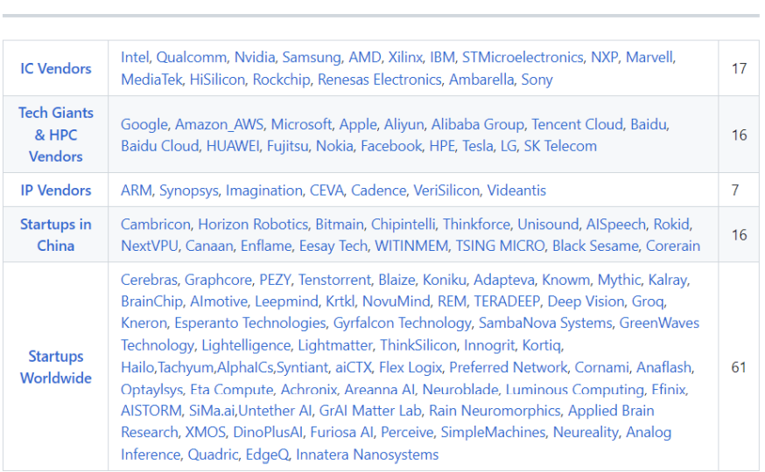
“ASIC” solutions will lead the market in 2025 followed by GPUs and CPUs
https://www.eenewseurope.com/news/ai-chip-market-set-rival-microcontrollers-0
https://github.com/basicmi/AI-Chip

Slide 11
Key Metrics and Design Objectives

Slide 12


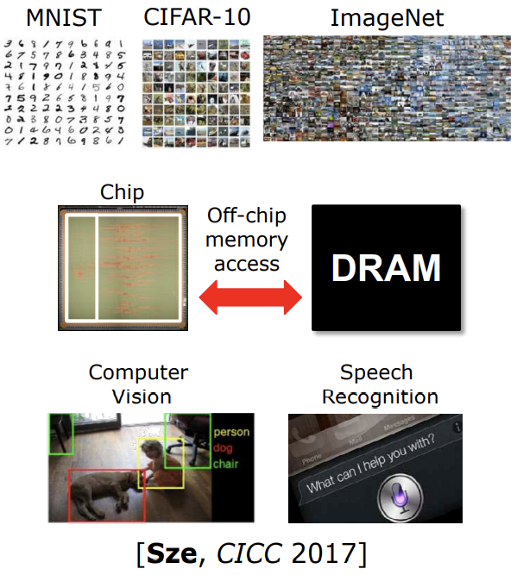





Slide 13

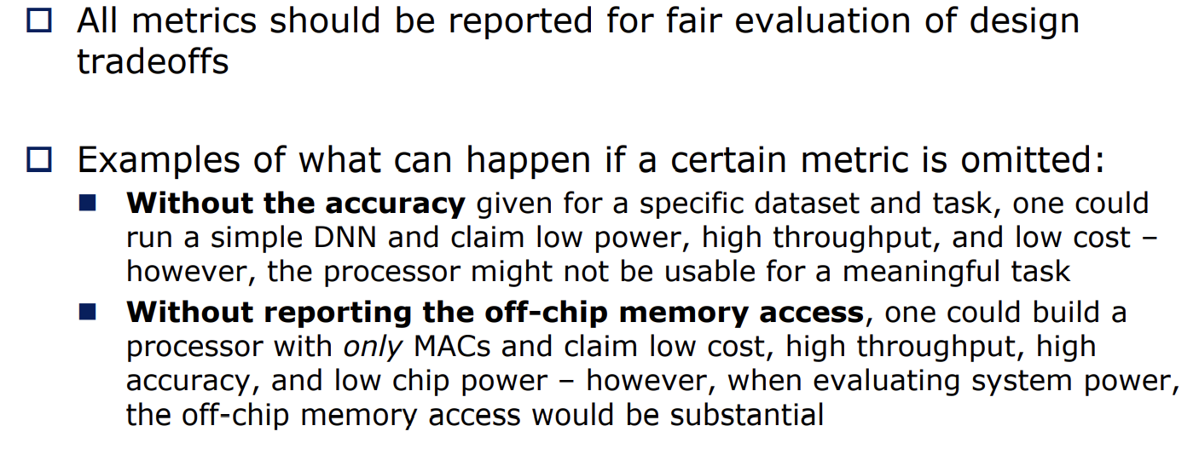

Slide 14
GPU & GPU Platforms

Slide 15

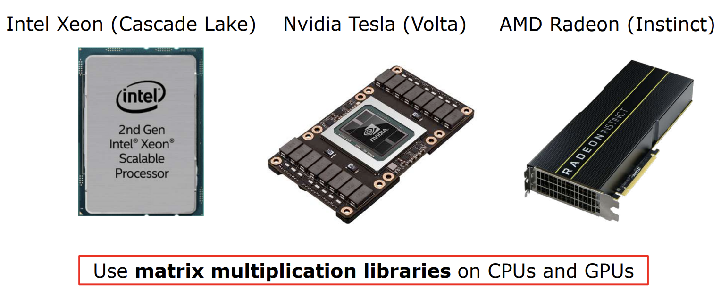

Slide 16

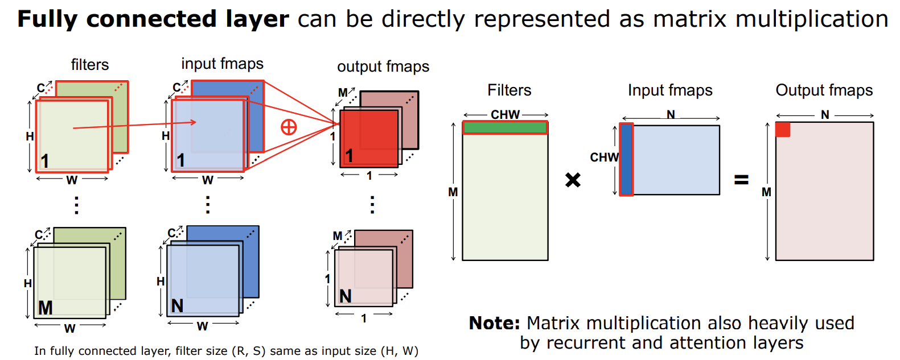

Slide 17

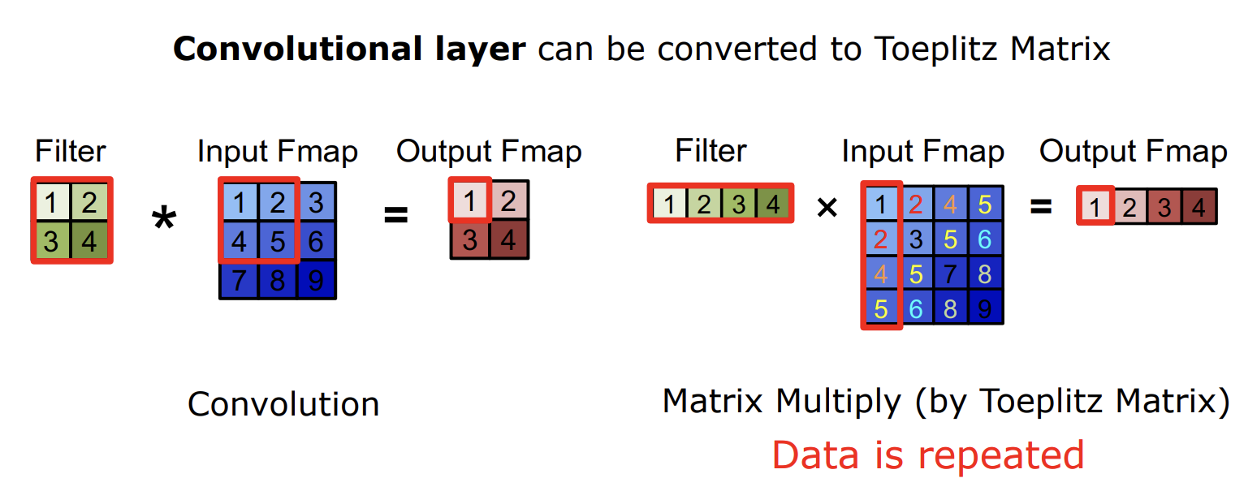

Slide 18

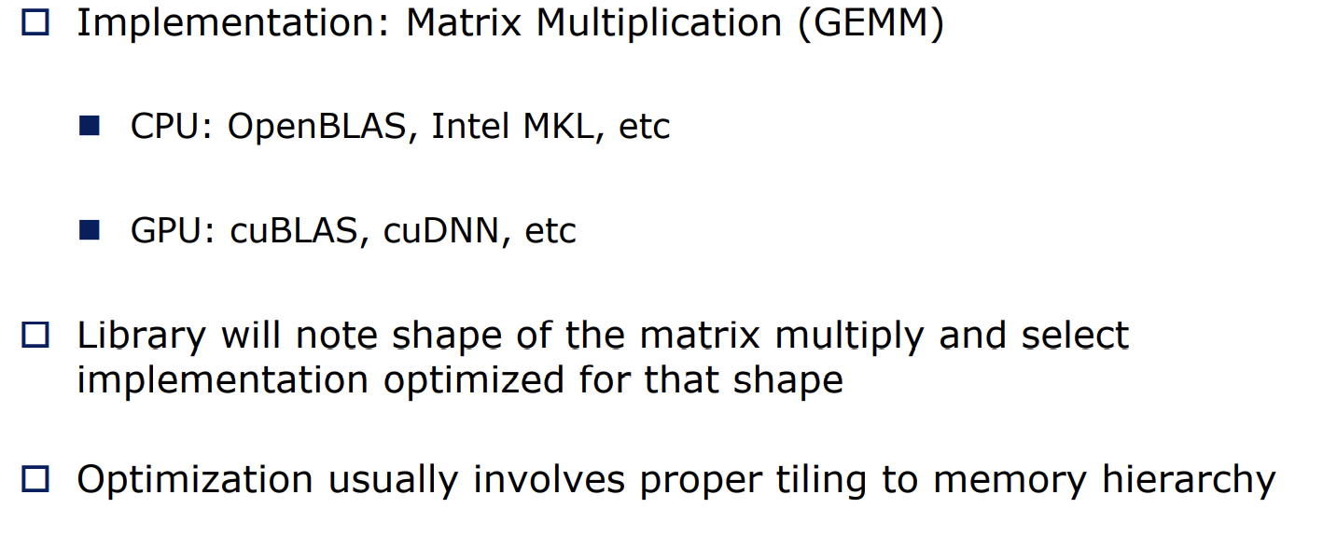

Slide 19

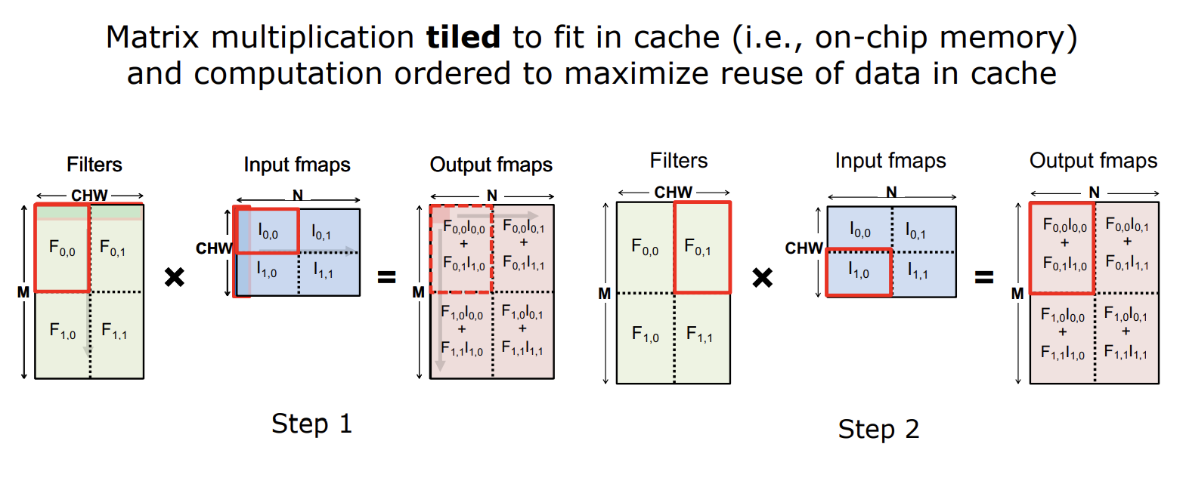

Slide 20

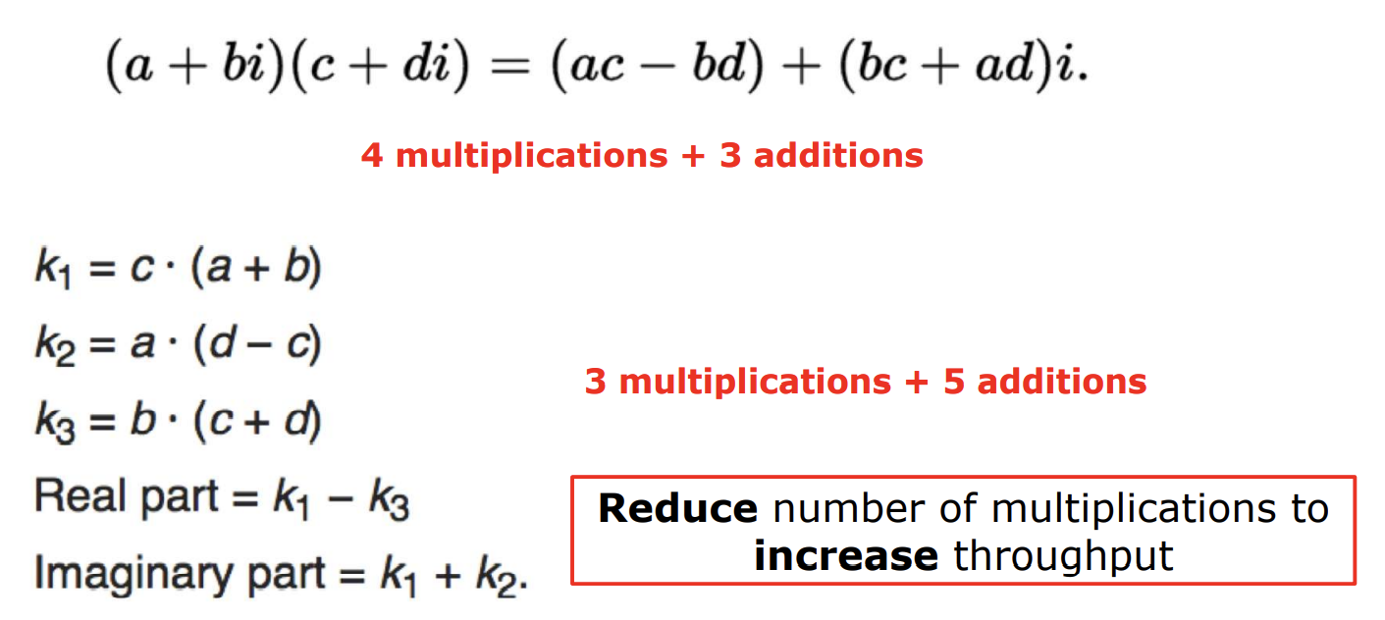

Slide 21

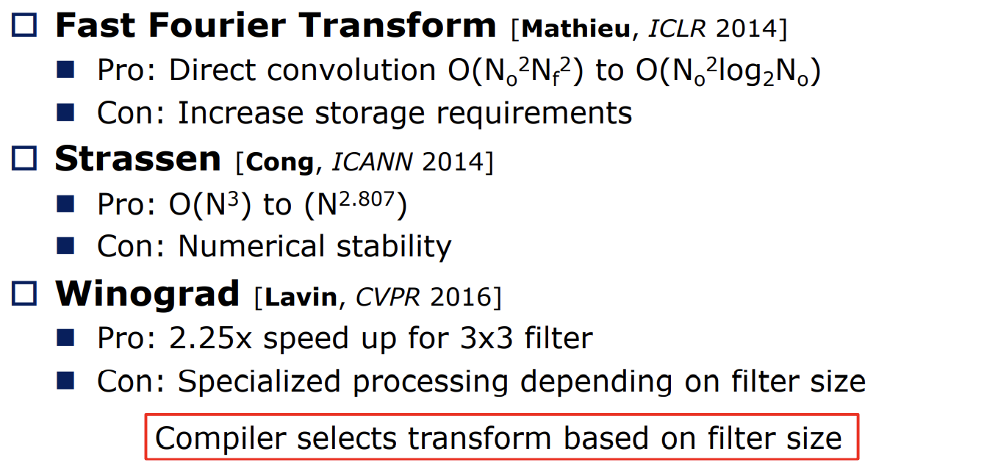

Slide 22

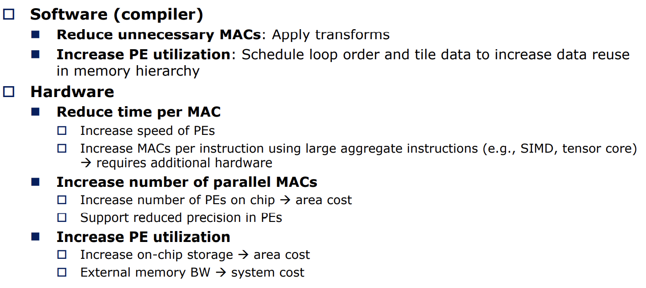

Slide 23
Specialized / Domain-Specific Hardware

Slide 24

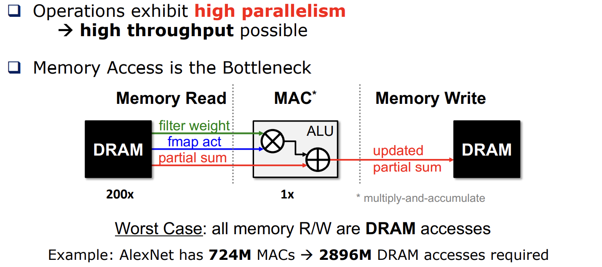

Slide 25
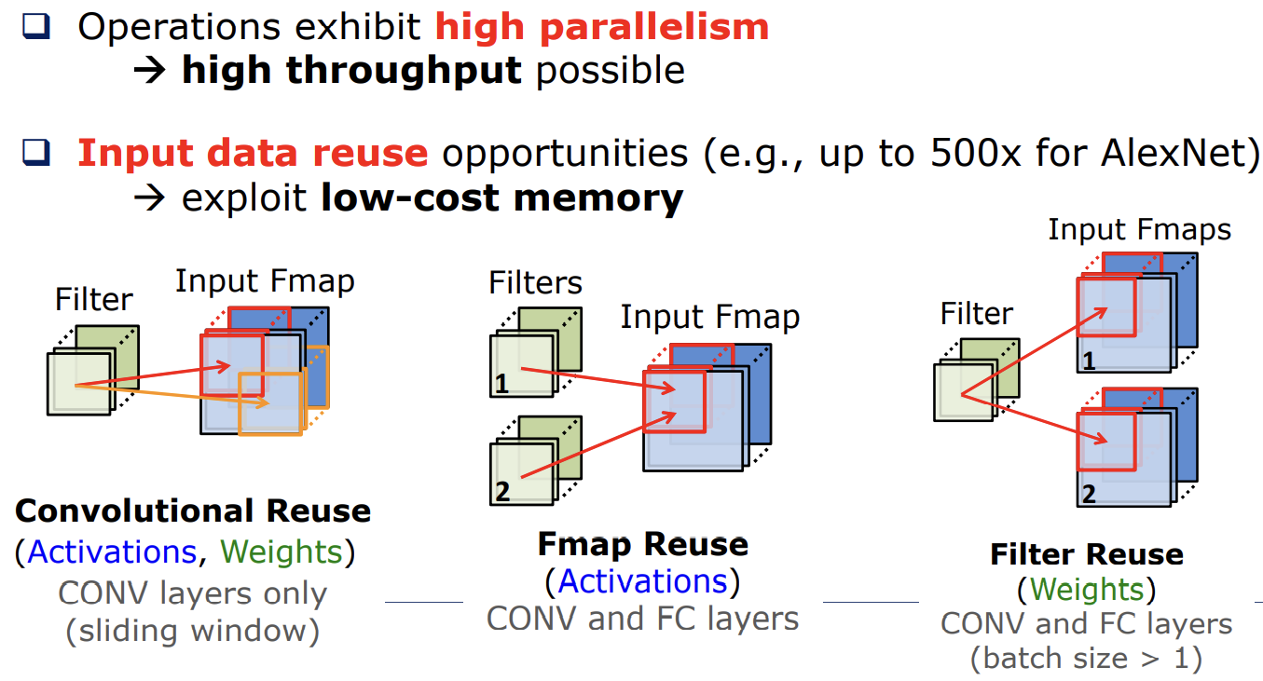

Slide 26

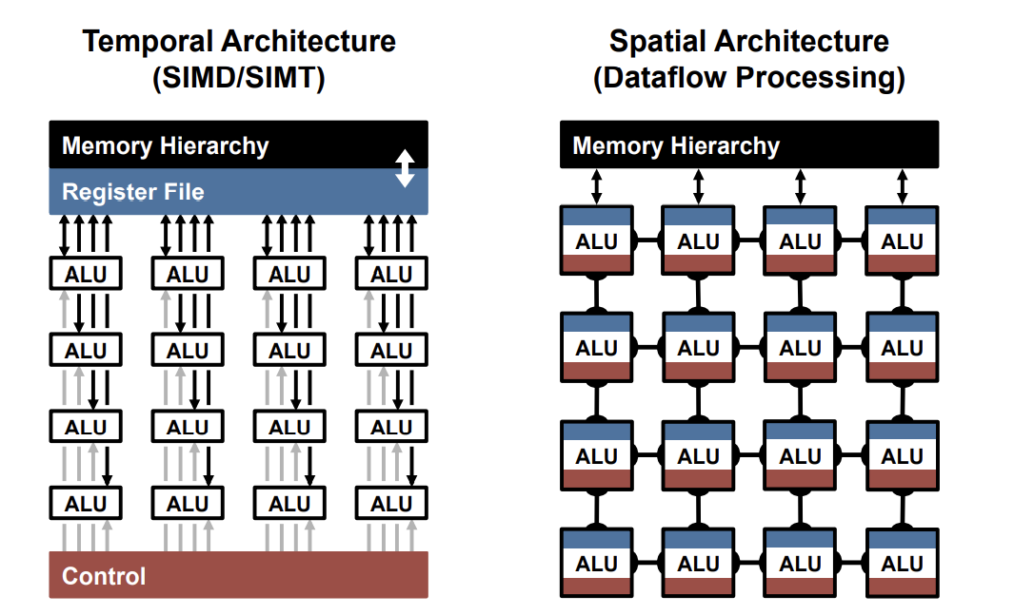

Slide 27

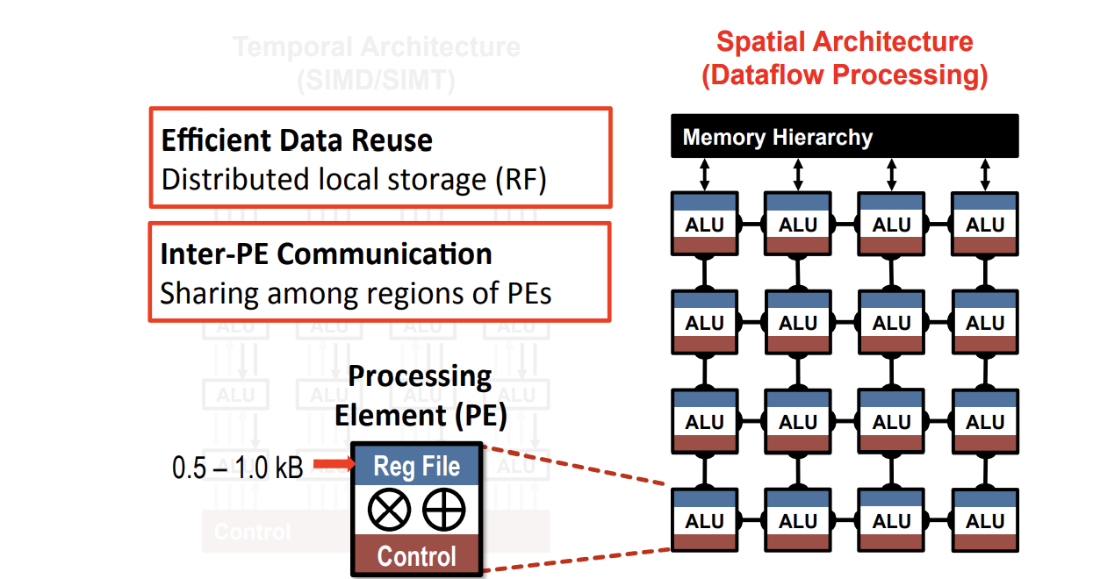

Slide 28
남은 주제들..
Efficient Dataflows, Algorithm&Hardware Co-Design, Reduced Precision, Sparsity, Efficient Nework Archiectures, Hardware In the Loop, Flexibility &Scalability, Other Platforms(FPGA, Intel과 AMD)

Slide 29
Reference
Yu-Hsin Chen, IEEE.(2016). Eyeriss: An Energy-Efficient Reconfigurable Accelerator for Deep Convolutional Neural Networks.
Vivienne Sze.(2019.09). Efficient Processing of Deep Neural Network: from Algorithms to Hardware Architectures.
Sze, Vivienne / Chen, Yu-Hsin / Yang, Tien-Ju. Efficient Processing of Deep Neural Network.

